Slide 1
DSBA 6211 Project Presentation
Stowe Rankin, Anuska Mondal, Eliza Lagua, Reese Cochran

Slide 2
Agenda
Introduction to the dataset
Project objectives
Model 1: Clustering
Model 2: Random Forest
Observations and results
Project challenges and future ideas

Slide 3
Introduction to the dataset: Amazon consumer behavior
Dataset includes a wide range of variables such as customer demographics, user interaction, and reviews.
Researchers and analysts can gain a deeper understanding of consumer behavior, identify trends, optimize marketing strategies, and improve the overall customer experience on Amazon.

Slide 4
Project goal and objectives - Analyze trends in consumer behavior
To accomplish this goal we used 2 techniques to further analyze and discover useful information in the dataset
The first thing we did was to perform K means clustering on the data
Next we created a Random Forest Model trying to predict the outcome on whether a cart is converted to a sale. This is an important metric to business highlighting the health of their customer base as well as their product offerings

Slide 5
Data Pre-Processing
Cleaning
Missing Variables: 2
Drop Non-informative variables
Transform Categorical Variables: Hot-encoding
Feature Engineering
Filter Age > 12
Correlation Analysis: ‘Customer Service’ x ‘Improvement Area’
K-means Prep
Standardization
Elbow Method
Notes:
We have decided to build a Customer Segmentation model using K-means. Firstly, we have dropped missing values, of which there were only two, then dropped columns that weren’t informative like ‘Personalized_Recommendation_Frequency’ and ‘Timestamp’. Next, we hot-encoded the categorical variables for further analysis and model building. We then identified 4 pairs of highly correlated variables, and from three of the pairs we dropped one variable each. We decided to keep the pair of ‘Improvement_Areas_Nothing’ and ‘Service_Appreciation_Cusomter_Service’, as it suggests that when customers appreciate the customer service, they also tend to report nothing to improve. Given that these insights are somewhat different in nature (one is positive feedback while the other is lack of negative feedback), we want to keep them both. We then proceeded to filter the ‘Age’ variable to take out ages less than 12. The next step was to standardize the data. Various columns (Age, Customer_Reviews_Importance, Rating_Accuracy, Personalized_Recommendation_Rating, Shopping_Satisfaction) are not binary and exhibit varying ranges and standard deviations. Standardizing these columns to have a mean of 0 and a standard deviation of 1 could be beneficial, especially since k-means relies on distances, making scales important. We then performed the k-means clustering. From Our K-means model we first determined the number of Clusters using the Elbow Method. We used 3 clusters in which we looked at the distribution of the data points in each cluster as well. We then created a PCA model to reduce our data to 2 and 3 dimensions for visualization.

Slide 6
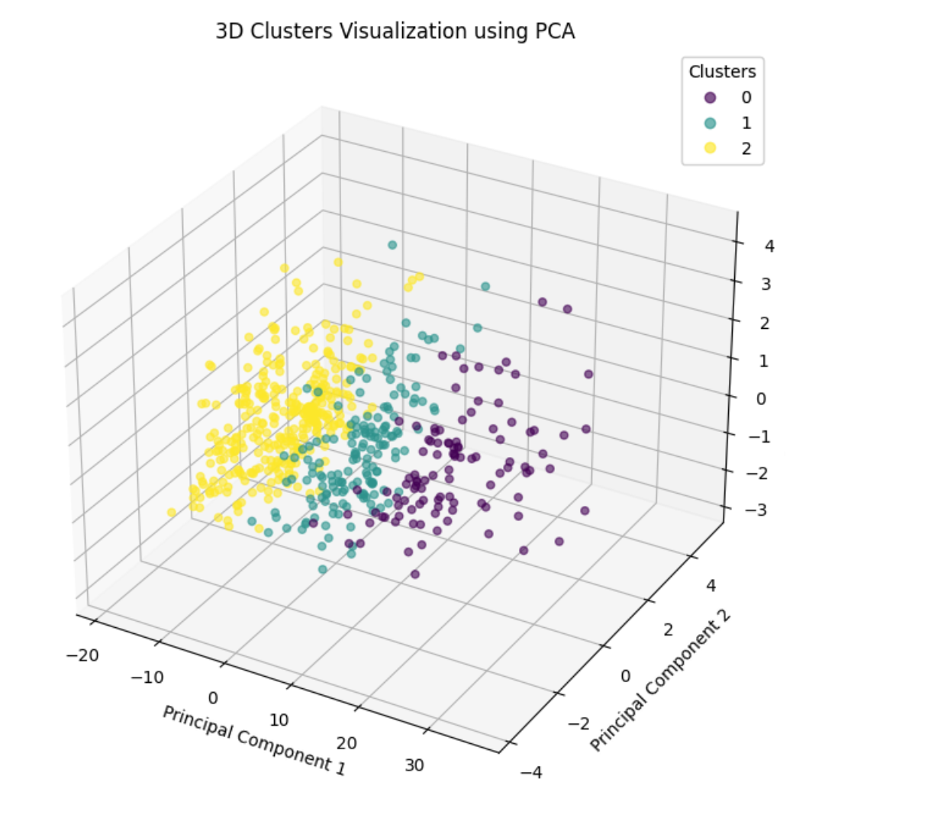
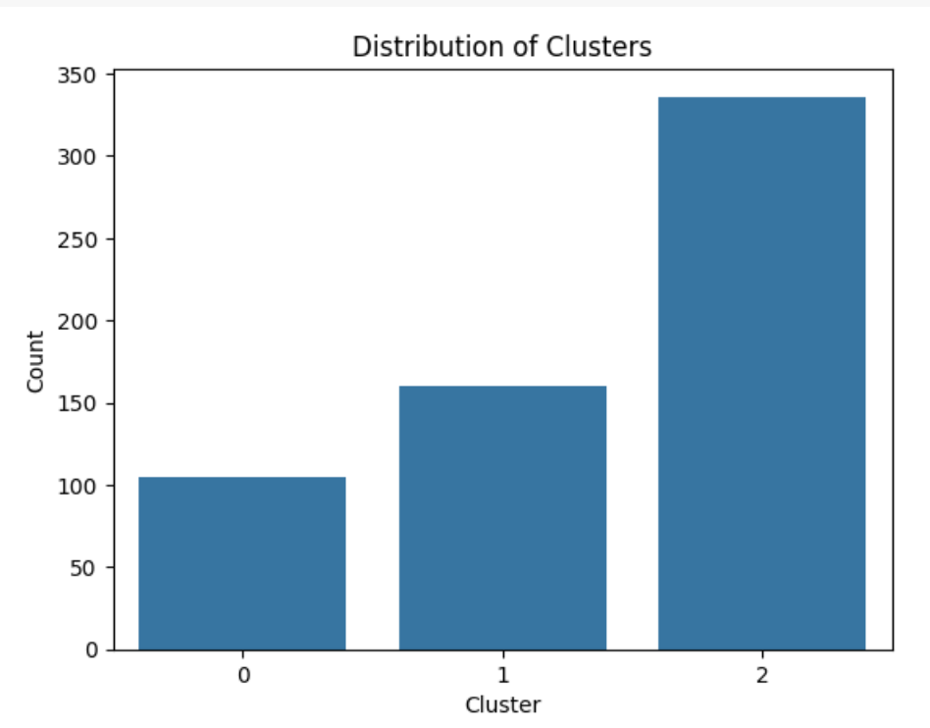
Notes:
Cluster 2 is huge, but that’s probably because of the age representation.
This plot shows a good separation between the clusters, particularly between Cluster 0 and the others, which suggests that the k-means algorithm is effectively distinguishing between at least some distinct groups in the dataset.
Clusters 1 and 2, while distinct, are closer to each other than to Cluster 0, indicating they might share some similarities. The overlap isn't too pronounced, which is generally good for cluster analysis, but it might be worth exploring if a different number of clusters or a different clustering algorithm might capture the nuances in the data better.

Slide 7

Custer 0: Average Age ~ 48.7
Behavior:
Moderate interest in reviews and personalized recommendations
Balanced view on shopping satisfaction
Engagement:
Lower frequency in browsing but uses a variety of product search methods
Moderate activity in adding items to carts and completing purchases
Notes:
This group comprises individuals likely in their mid to late careers or retirees, characterized by a moderate interest in reviews, personalized recommendations, and a balanced view on shopping satisfaction. Despite their lower frequency in browsing, they utilize a variety of product search methods and show moderate activity in adding items to carts and completing purchases. To engage this demographic effectively, Amazon should focus on marketing communications that emphasize reliability, quality, and customer service. Enhancements in loyalty programs that reward consistent purchasing and introduce benefits for referrals could significantly increase engagement among this steady group. Personalized communications, such as tailored newsletters featuring products suited to their lifestyle, would also resonate well.

Slide 8
Custer 0: Average Age ~ 48.7
Marketing Strategies:
Focus communications on reliability, quality, and customer service
Enhance loyalty programs to reward consistent purchases and introduce referral benefits
Communication Strategies:
Implement personalized communications, such as newsletters tailored to their lifestyle needs
Notes:
Since they do have modest interest in reviews and recommendations, we suggest focusing on communicating things like reliability, quality and customer service to this demographic. And we award this demographic with enhanced loyalty programs or referral benefits to reward their consistent purchases. We would also suggest personalized communications techniques to reach this demographic like newsletters that are tailored to their lifestyle needs.

Slide 9

Cluster 1: Average Age ~ 34.8
Behavior:
Moderate to high importance on reviews
Slightly lower shopping satisfaction compared to Cluster 0
Engagement:
High activity in browsing and purchasing
Frequent purchasing patterns
Notes:
This segment includes individuals likely in their early to mid-career, showing behaviors similar to Cluster 0 in terms of reviews importance \. They are from moderate to high for their review and recommendations importance. But they have a slightly lower shopping satisfaction. They do have high activity in browning and purchasing.

Slide 10
Cluster 1: Average Age ~ 34.8
Marketing Strategies:
Deploy frequent, targeted marketing campaigns
Utilize time-sensitive offers to prompt quicker decision-making
Community and Interaction:
Boost engagement through integrated social media, reviews, and interactive forums.
Notes:
Goal: Increase engagement and foster brand loyalty through active community interaction and targeted offers
This demographic is already highly engaged, so the goal to reach this demographic would be targeted marketing campaigns with time-sensitive offers to encourage quicker decision-making. Since this group is active and engaged, creating opportunities for feedback and interaction through social media and customer reviews could enhance their influence across their networks. Additionally, building online communities or forums where they can exchange opinions and experiences may further increase engagement and brand loyalty.

Slide 11

Cluster 2: Average Age ~ 23.4
Behavior:
Highly responsive to personalized recommendations
Fairly high shopping satisfaction
Engagement:
Very active in browsing, frequently using keyword searches
High add-to-cart rates and 'Yes' responses for browsing
Highest cart abandonment rates
Notes:
The final Cluster represents the youngest demographic, likely comprising college students and early career individuals. They have high responsiveness to personalized recommendations and relatively high shopping satisfaction. They also exhibit the highest rate of cart abandonment due to better prices found elsewhere.

Slide 12
Cluster 2: Average Age ~ 23.4
Strategic Actions:
Implement dynamic pricing strategies like price matching and special student discounts
Enhance the mobile app to be more user-friendly, fast, and efficient
Introduce features like app-exclusive deals and improved recommendation algorithms
Notes:
To address this issue, Amazon should implement dynamic pricing strategies, such as price matching or special student discounts during flash sales. Finally, Enhancing the mobile app experience is crucial for this tech-savvy group. We should ensure that the interface is user-friendly, fast, and efficient, with features like app-exclusive deals and improved recommendation algorithms that cater to their preferences and behaviors.

Slide 13
RF Introduction
The first thing we needed to do was create our target variable. The dataset initially had a column called Cart_Completion_Frequency, which tracks the frequency of times an item put in the cart is converted to a sale. This column had 5 outcomes ranging from Always, Often, Sometimes, Rarely, and Never.
Sometimes had a value count of 304 which was over half of the dataset. Sometimes is someone considered 50/50 to complete their purchase. Targeting this group to increase their rate is highly important. A company the size of Amazon even being able to slight improvements can lead to large financial gains.

Slide 14
Methodology and model creation
Created new column where Cart_Completion was Yes or No. To do this Always and Often became Yes and Rarely and Never became No. Sometimes was Randomly split into Yes and No
Feature Columns were Age, Gender, Browsing Frequency, Purchase Frequency, and Shopping Satisfaction
Goal is to be able to predict whether a cart will be completed and see why
Create an initial decision tree and RF model with hyperparameter tuning

Slide 15
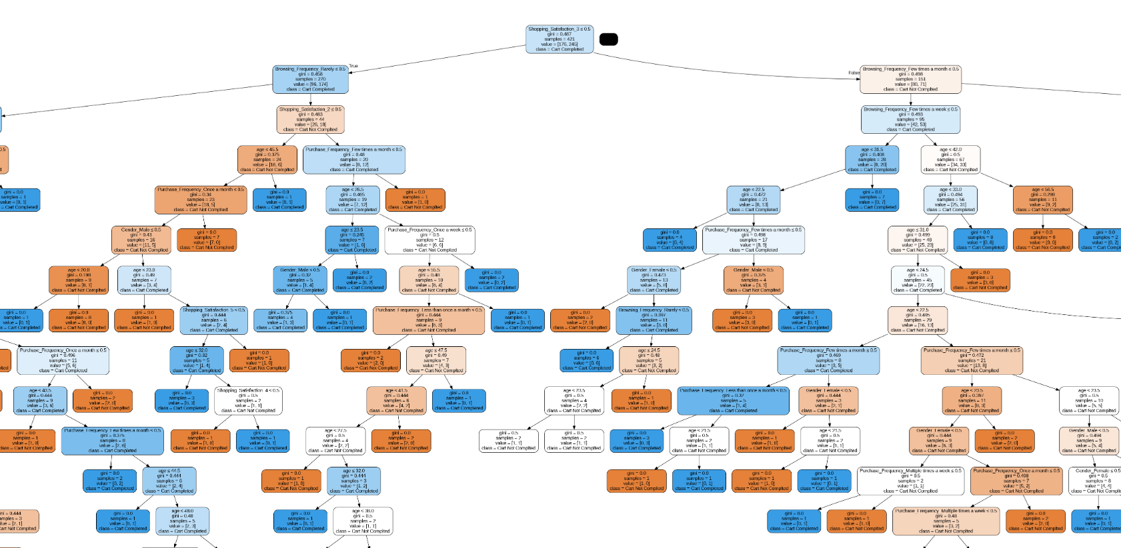
Initial Findings
Initial takeaways - Age > 45 as well as male is indicator for not completing.
Surprised by initial split where rarely was indicating yes and few times a month was No.
Initial decision tree - Blue = Yes, Orange = No

Slide 16
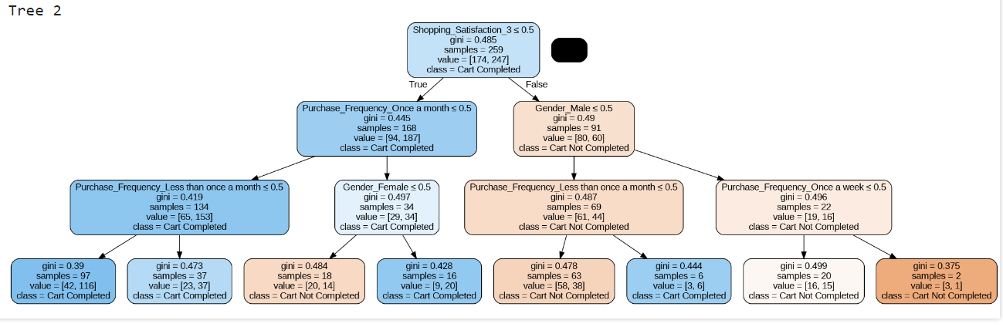
Random Forest Model
Initial Random Forest Model had Test Accuracy of .55
Ran HyperParameter Tuning - Adjusted the max depth to 3, as well as 150 for n-estimators
With tuning Model Accuracy jumped to .60

Slide 17
RF Takeaways
Once again gender was one of the clearer identifiers as Female were more likely to complete to male
Also noticed once again that low purchase frequency still had high rate. We think this is attributed to group of shopper that only log on to buy something
While we would wish for higher accuracy as mentioned before even slight increases with a company dealing in the Volume of Amazon can have major impacts

Slide 18
Challenges with our data and future suggestions
Across both models were major challenges:
-The size of the dataset
-Preprocessing and cleaning the data; getting the data ready posed a challenge
-Deciding on number of clusters along with validation if clusters were done correctly
-Conducted a PCA model to reduce our data to lower dimensions for better visualization
-Within feature selection, it was difficult to decide which variables to keep or not to keep as their were a lot of variables.
Future suggestions would include further sampling to increase the size of the dataset as well as continued tests and changes to the combinations of feature columns selected as independent variables
Notes:
604 rows and 23 columns

Slide 19
Thank you!
Questions?

